Slide 1
Revolutionizing Shopping: The Smart Trolley

Slide 2
LIST OF CONTENTS
Introduction
Components Required
Features of Smart Trolley
Benefits of Smarty Trolley for Customers
Benefits of Smart Trolley for Retailers
Challenges in Implementing Smart Trolley
Future of Smart Trolley
Conclusion

Slide 3

Introduction
Smart trolleys are becoming increasingly popular in retail stores as they offer a range of benefits to both customers and retailers.
These trolleys are equipped with various features such as sensors, cameras, and displays that enhance the shopping experience and make it more convenient for shoppers.

Slide 4
Components Used
Barcode Scanner
ESP 32
TFT Display
Connecting wires
HX711

Slide 5
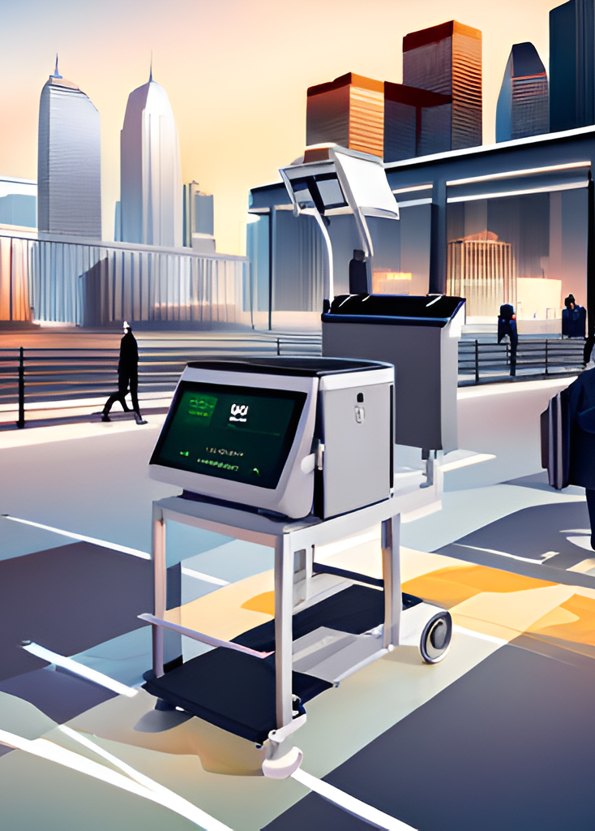
Features of Smart Trolley
Smart trolleys come equipped with a range of features that make them stand out from traditional trolleys. Some of these features include RFID scanners, weight sensors, cameras and touchscreens.
Barcode Scanner scanners are used to scan the barcodes on products and keep track of the items placed inside the trolley. Weight sensors help calculate the total cost of the items and ensure that customers do not exceed their budget. Cameras are used to capture images of the products and provide customers with detailed information about them. Touchscreens allow customers to browse through products and access personalized recommendations.

Slide 6

Benefits of Smart Trolley for Customers
Smart trolleys offer a range of benefits for both customers and retailers.
For customers, they provide a more personalized shopping experience by offering tailored recommendations and promotions based on their shopping history and preferences.

Slide 7

Benefits of Smart Trolley for Retailers
For retailers, smart trolleys provide valuable insights into customer behavior and preferences, which can be used to improve store layout, product placement and marketing strategies.
They also help reduce labor costs by automating the checkout process and minimizing the need for staff to restock shelves.

Slide 8

Challenges of Implementing Smart Trolleys
While smart trolleys offer a range of benefits, some challenges are associated with implementing them. One of the main challenges is the cost of installing and maintaining the technology required to operate the trolleys.
Another challenge is ensuring that the technology is user-friendly and easy to use for all customers, including those who may not be familiar with the latest digital technologies. Finally, there is also the risk of privacy concerns, as the data collected by smart trolleys may be sensitive and require strict security measures.

Slide 9

Future of Smart Trolley
Despite the challenges, the future of smart trolleys looks bright. As the technology becomes more advanced and affordable, we can expect to see more retailers adopting this innovative solution to enhance the shopping experience for their customers.
In the future, we may also see smart trolleys being integrated with other technologies such as augmented reality and artificial intelligence, which will further enhance the shopping experience and provide even more personalized recommendations and promotions.

Slide 10

Conclusion
Smart trolleys are a game-changer in the retail industry, providing customers with a more personalized and convenient shopping experience while also offering valuable insights for retailers. While there are challenges associated with implementing this technology, the benefits far outweigh the costs.
As the technology continues to evolve, we can expect to see even more exciting innovations in the world of smart trolleys that will transform the way we shop and interact with our favorite brands.

